Slide 1





PRESENTATION 2026
AI That Thinks Like a CEO: The
Future of Intelligent Enterprises
Mentor Name
Student Name
Student Email
UMA MAHESWARI
N.POOJA
leelalal050@gmail.com

Slide 2

Outline
Abstract of the Project
Problem Statement
Proposed Solution
System Architecture
Live Demo of the Project
Embedded Video of Project
Conclusion
Future Scope

Slide 3
Abstract
This project ,addresses real-world business challenges such as declining sales, inefficient operations, and delayed decision-making by using AI to replicate strategic thinking at the executive level.
The objective is to leverage AI to analyze large volumes of business data, identify patterns, predict future trends, and automate key decisions so companies can respond quickly to market changes and improve overall performance. For example, in a retail business facing unpredictable customer demand, AI can forecast sales, optimize inventory, and recommend pricing strategies.
To build this solution, tools like Microsoft Excel are used for cleaning and organizing raw data, Power BI for creating interactive dashboards that visualize key metrics, ChatGPT for generating insights and strategic recommendations, and GitHub for automating analysis and improving efficiency.
The outcome is a structured dataset, clear visual reports, and actionable insights that enable faster, data-driven decision-making, ultimately helping businesses operate more intelligently and competitively in real-world scenarios.
+

Slide 4

Problem Statement
Many small and medium-sized businesses struggle to make the right decisions at the right time because they depend on guesswork instead of data. For example, a local retail store may not know which products sell the most, when customers usually buy, or how to set the right price, leading to unsold stock, low profits, and missed opportunities.
Since the data is often scattered and not properly analyzed, business owners find it difficult to plan ahead or respond quickly to changes in customer demand.
This creates a need for an intelligent system like “AI That Thinks Like a CEO – The Future of Intelligent Enterprises”, which can analyze business data, identify patterns, and give simple, clear suggestions for better decisions. By using tools such as Microsoft Excel, Power BI, ChatGPT, and GitHub Copilot, businesses can understand their data easily, make smarter choices, and improve their overall performance in a real-world scenario.

Slide 5

Proposed Solution
To address these business challenges, the proposed solution is to develop an intelligent system ,which uses data to support smart and timely decision-making. The system will collect and organize business data such as sales, customer behavior, and inventory using Microsoft Excel, and then transform this data into easy-to-understand visual dashboards through Power BI.
AI tools like ChatGPT will analyze the data to identify patterns, predict future trends, and provide simple recommendations such as which products to restock, when to offer discounts, or how to improve sales. Additionally, GitHub Copilot can be used to automate repetitive tasks and improve efficiency in data processing.
This solution helps business owners make faster, smarter, and data-driven decisions without needing deep technical knowledge, ultimately improving profitability, reducing losses, and enabling the business to operate more intelligently in real-world situations.

Slide 6
System Architecture
Data Input / Source
Processing / Analysis
file with 500 rows of date, company ID, industry, revenue, operational,cost,profit, market growth, customer satisafaction, employee productivity, risk level, investment in AI, AI recommendation, decision taken , decision outcome, CEO override, region.
This data is collected from retail or business transactions and then cleaned and organized using Microsoft Excel to ensure accuracy.
involves cleaning and organizing raw business data such as sales, customer behavior, and inventory using Microsoft Excel to remove errors and ensure accuracy.
The processed data is then analyzed to identify patterns like high-demand products, customer buying trends, and stock performance, which helps understand business strengths and weaknesses.

Slide 7
AI / Tool Integration
Output / Dashboard
focuses on combining multiple technologies to create smarter business decision-making. Business data such as sales, customer behavior, and inventory is first managed and prepared using Microsoft Excel, and then transformed into interactive dashboards through Power BI for clear visualization of business performance.
AI tools like ChatGPT are integrated to analyze patterns, generate insights, and suggest strategic. This integration helps create an intelligent system that acts like a CEO by supporting faster, data-driven, and accurate business decisions.
interactive business intelligence system that clearly presents key insights from sales, customer behavior, and inventory data in an easy-to-understand visual format. Using Power BI, the dashboard displays important metrics such as top-selling products, profit trends, demand forecasting, and stock levels to help identify business performance patterns in real time.
The insights generated through ChatGPT and processed data from Microsoft Excel help convert complex data into simple recommendations, while GitHub Copilot supports automation behind the system. This output enables business owners to make quick, accurate, and data-driven decisions just like a CEO.

Slide 8
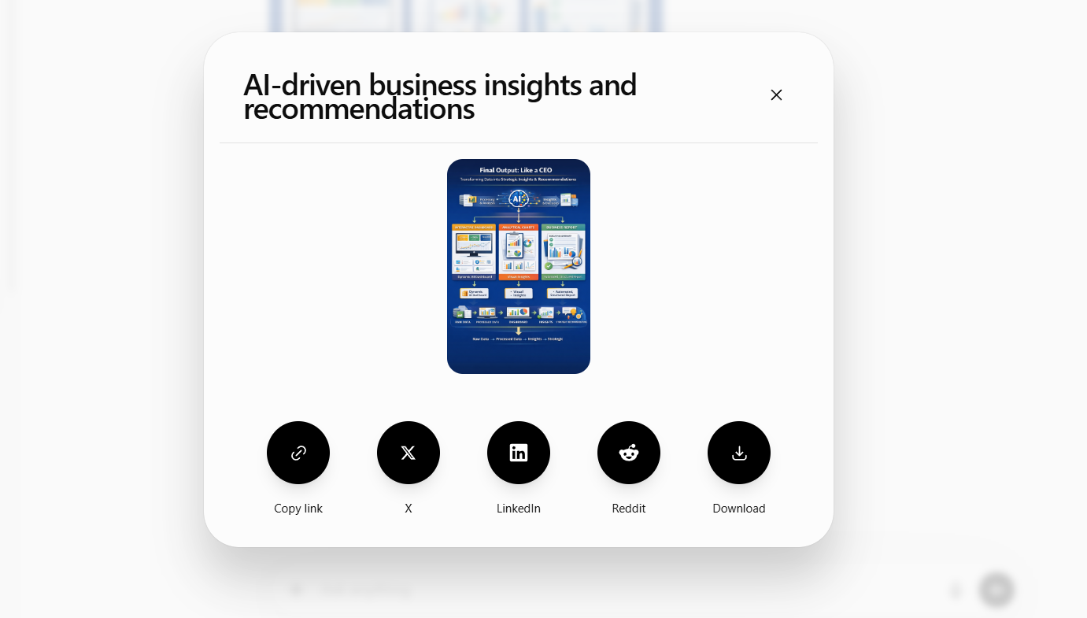
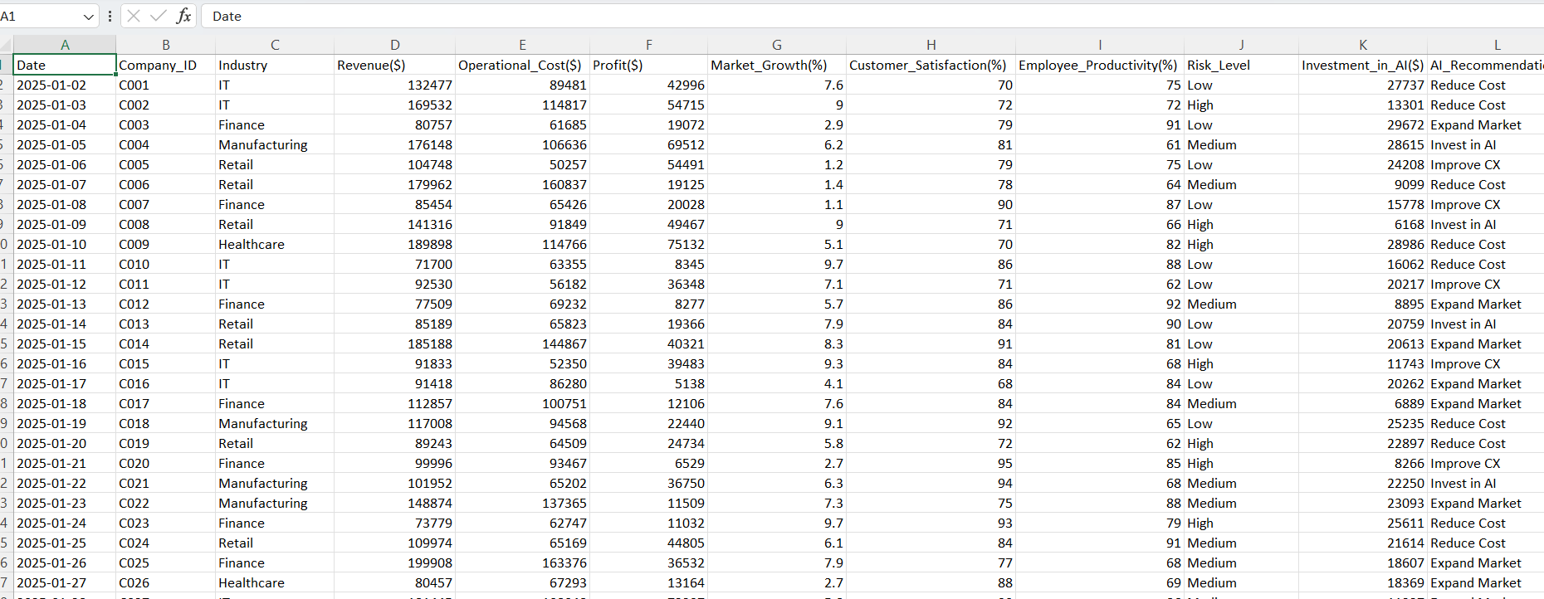
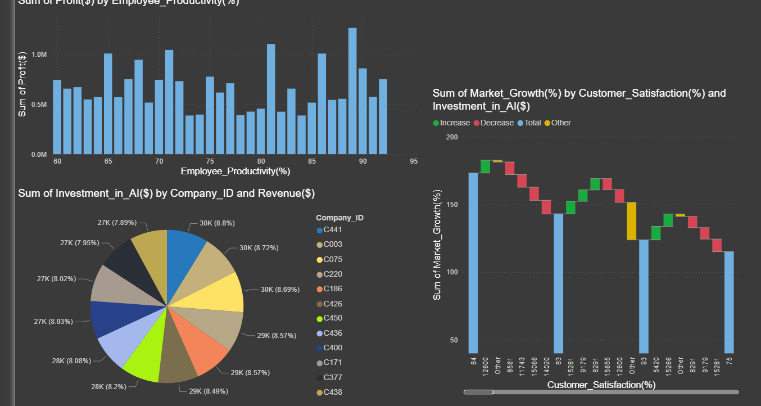
Live Demo of Project
Here's the list of some demo screenshots / features of the project:
Demo 1
Demo 2
Demo 3

Slide 9
Video of Project Demo
[https://your-project-demo-link.com]
▶
[Insert your project demo video.
You can embed a video your live project.]

Slide 10

This project demonstrates how the integration of data analytics, artificial intelligence, and business intelligence tools can transform traditional decision-making into a smart, automated, and strategic process.
By combining tools like Excel, Power BI,the system successfully converts raw data into meaningful insights, enabling organizations to make data-driven decisions similar to a CEO’s thinking process.
AI does not replace a CEO—it enhances decision-making by providing faster, smarter, and more data-driven insights.
Conclusion
CONCLUSION

Slide 11

Future Scope
Advanced AI & Deep Learning Integration
In the future, AI will not just assist CEOs—it will act as a strategic partner, transforming organizations into intelligent, self-driven enterprises.”
the system can be enhanced with advanced AI models to perform predictive analytics, demand forecasting, and risk analysis for different industries such as retail, manufacturing, and finance. Integration with live business databases and cloud platforms will allow real-time data processing and smarter automation.

Slide 12
Thank You
AICW Fellowship | Student Project Presentation 2026
LinkedIn | Edunet Foundation

